Slide 1
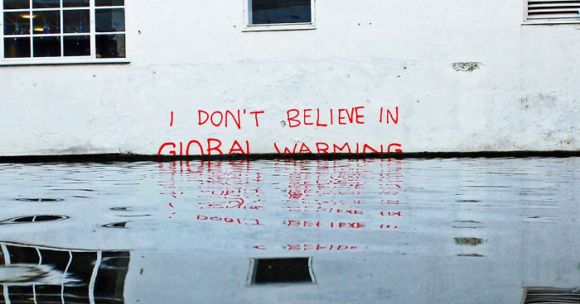
Toxic In/Justice: Green Criminology and Environmental Protest
Intro: Toxic In/Justice stems from two parents: ‘green criminology’, and critical criminology. It is the study of…
… general harms and crimes against the environment,
… corporate crimes against the social environment,
… social protest against those crimes, and environmental justice, and
… environmental law and policy.
This course highlights how these harms are systemic and structural, as are the reasons for their persistence and the failure to remediate them.
This course stresses the need for action.

Slide 2
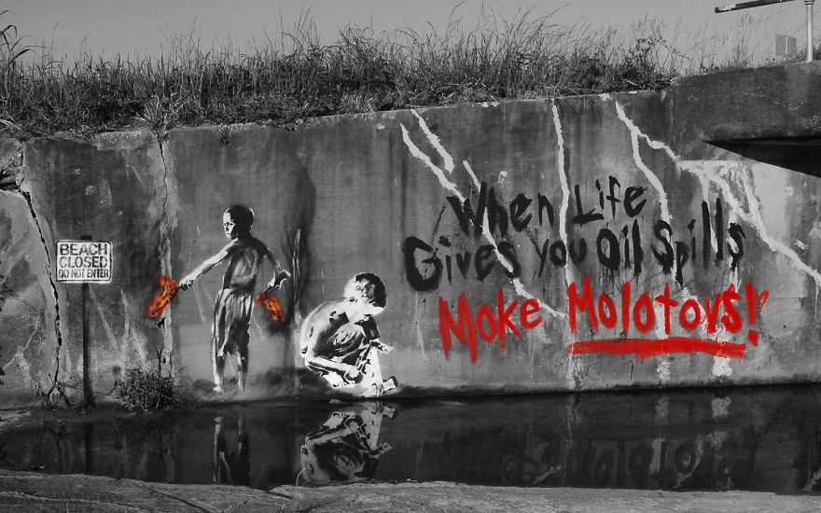
The course will cover topics such as:
… wildlife crimes, and animal abuse,
… the causes of environmental crime,
… legal and administrative regulation,
… natural exploitation, and biopiracy,
… environmental activism,
… policing, prosecution and monitoring.
Recent examples: ongoing Flint Michigan lead in the water crisis, the 2016 Fort McMurray fire made worse by climate change, and the 2010 BP oil spill.
Older examples: grounding of the Exxon Valdez off the coast of Alaska, the release of isocyanate gas in Bhopal, India, the Minimata disaster in Japan, the Greenpeace crusade against whaling, and the ongoing pollution at Grassy Narrows.

Slide 3
Green criminology became widely recognized in the late 1990s (Beirne et al., 1998; Lynch 2003). It looks at crimes that criminology ordinarily fail to address:
“The core idea … is that humans harm the environment – by which green criminologists mean:
… the whole ecosystem (Gaia, or the living planet earth),
… components of the ecosystem (e.g., air, land, water, forests), and species that inhabit ecosystems in serious ways.
Some of those harms are defined as crimes under law, while a significant volume of that harm has yet to be defined as illegal.” http://greencriminology.org/950-2/#

Slide 4
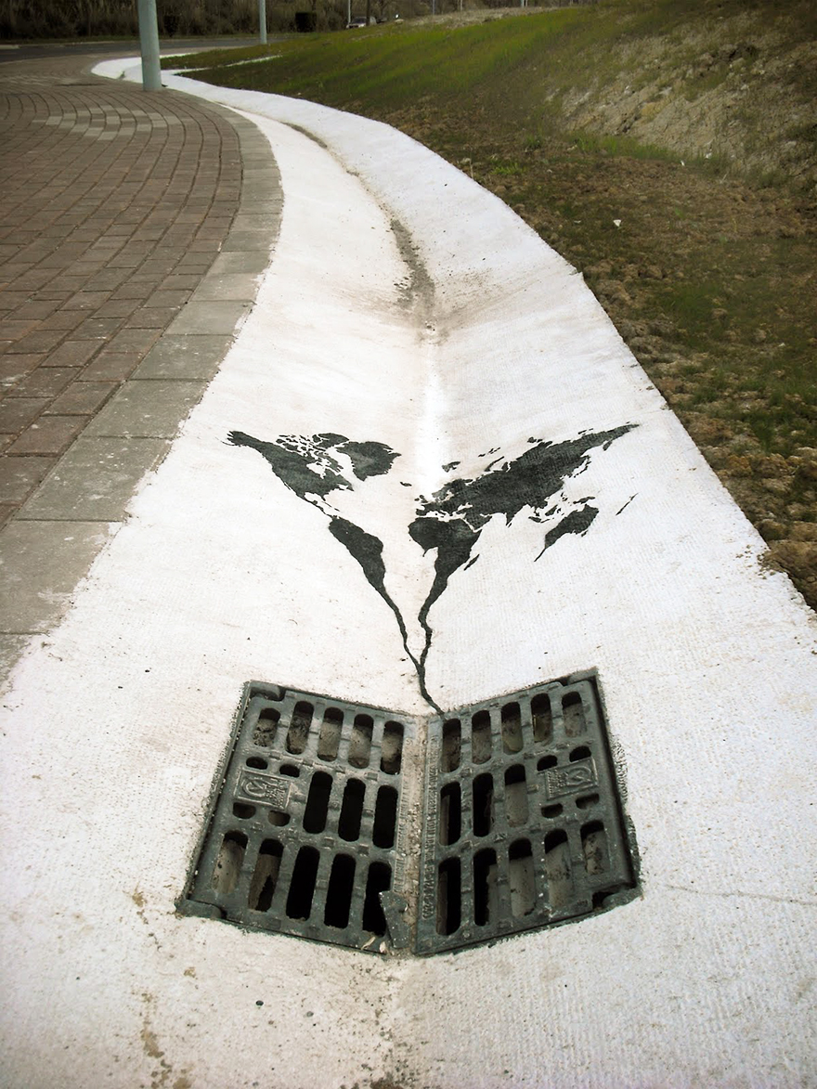
Critical criminology is interested in the use and abuse of power, such as corporate, government, and professional crime. Using a 21st Century analytical sensibility, the crisis is now different…
It is not simply the pollution of rivers and the contamination of food sources, as at Minimata and Grassy Narrows; or, the presence of dioxins in baby diapers caused by chlorine bleaching of wood pulp.

Slide 5
The environmental crisis is now made worse by
mass migration, globalization and the plutocratic greed of the one percent,
climate change knowingly brought on by fossil fuel exploitation,
Terrorism, counter-terrorism, cyber crime, and counter-activism,
civil unrest and its suppression by an expanding surveillance state allied with the fossil fuel industry in particular (eg. Project SITKA),
indigenous mobilization around environmental issues (eg. Dakota pipeline, Rexton anti-fracking),
a growing ‘precariat’, and so on.

Slide 6
Toxic in/justice…
The title for the course topicalizes the toxicity of these crimes, the cost to communities and the environment, and the search for environmental justice through social protest, and legal activism.

Slide 7
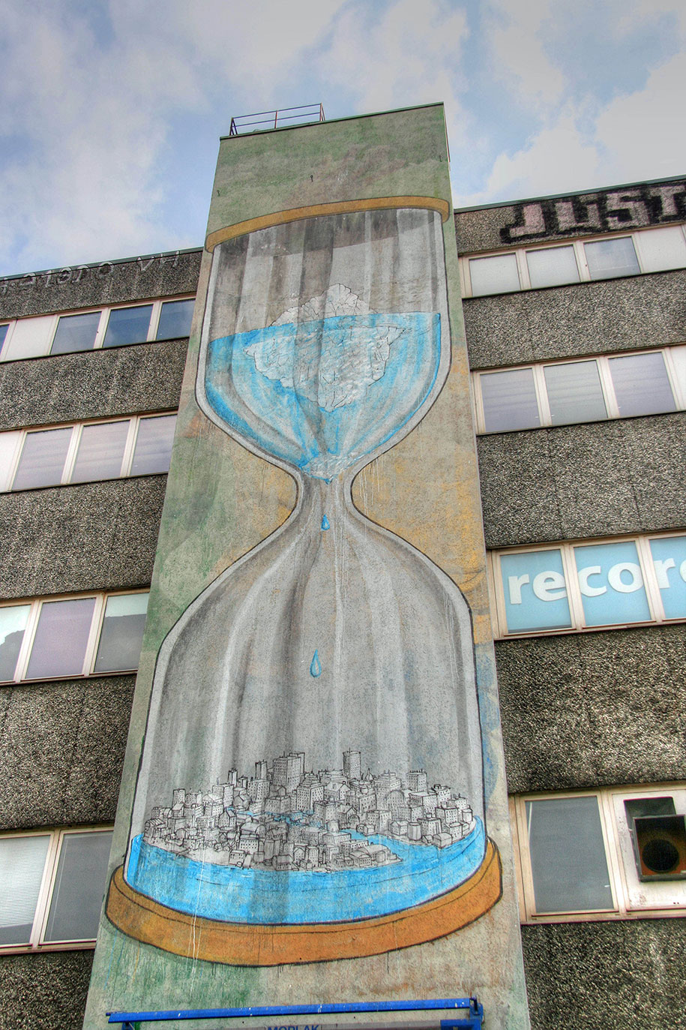
The course is a relatively new and growing part of the criminological field focusing on environmental crime and social protest.
Fitting in a multi-disciplinary program, it includes issues of biology, economics, politics, sociology, and of course psychology.
The approach is case-based, driven by critical theoretical issues, and delivered by lecture and through group work.

Slide 8
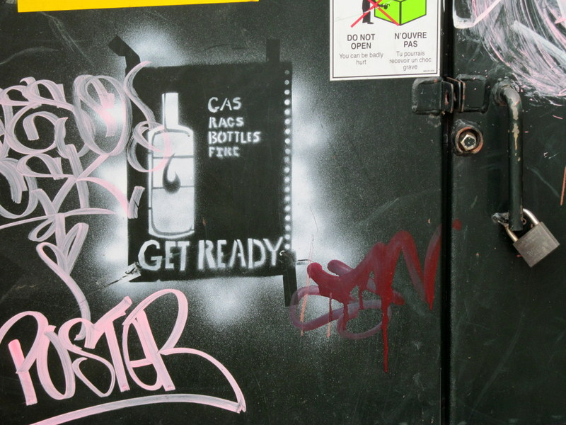
There is a gathering storm of global crisis and discontent which greatly overwhelms the issue of the laundering of PCBs in home fuel oil twenty years ago.
Criminology, with its roots in the 19th Century, and its development in the 20th, now must re/define its/self to face these changes in the 21st.

Slide 9
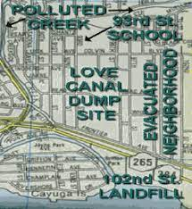
Learning topics: introduction to green criminology; a brief history of the environmental movement; select tipping-point cases (eg. Grassy Narrows, Love Canal, Exxon Valdez, Summit goldmine); environmental protection cases (eg. toxic cleanup and the development of Superfund sites);
… protests against environmental harm (eg. clearcut and old growth timber logging, fracking, select species fishing, uranium and gold extraction);
…worker and environmental protection in offshore zones worldwide; the global economy and the downstreaming of toxic waste; first world exploitation of ‘blood minerals’; and so on.

