Slide 1
The Brain, Movement and Learning
by Ben Dowling & Chantal Harris

Slide 2
Warm Up

Slide 3
Running Order
Overview of Jensen’s chapter on the brain and learning
Neuroplasticity: Neuron and Chemical activity
Motivation and the Brain
Strategies for Elementary
- Body Break -
Kinulations : Dr.Grant Williams
Incorporating movement strategies for secondary
Michael Kuczala
Kinesthetic Learning
ADHD

Slide 4
Teaching with The Brain in Mind
Eric Jensen (2005)
Chapter 4 - Movement and Learning

Slide 5
“Sit and Git”

Slide 6
The model for school lessons has always been
‘sit and git’,
which is both ‘embarrassing’ and ‘astonishing’.
The evidence that this set up is not only the worst way that people learn, but also that it is counterproductive to
natural learning

Slide 7
· Physical Education classes
· Breaks
· Recess
· Energizers
· Classroom Activities
“For many decades, in both the scientific and the educational communities, the dominant idea was that thinking and movement were completely distinct from each other” -Eric Jensen

Slide 8
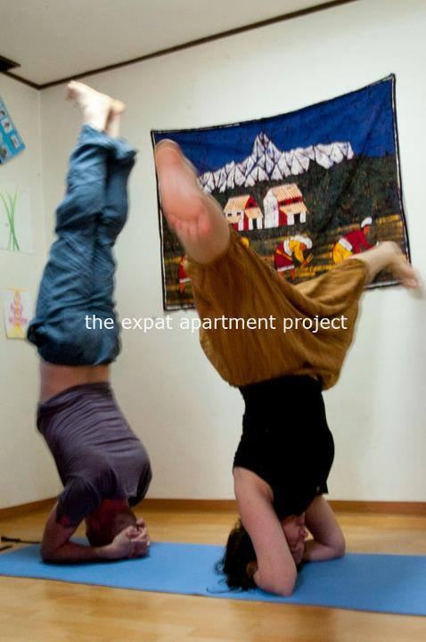
Yoga and Mindfulness
In a study ta team led by Harvard-affiliated researchers at Massachusetts General Hospital (MGH) reported the results of their study, the first to document meditation-produced changes over time in the brain’s gray matter.
“Although the practice of meditation is associated with a sense of peacefulness and physical relaxation, practitioners have long claimed that meditation also provides cognitive and psychological benefits that persist throughout the day,”
senior author Sara Lazar of the MGH Psychiatric Neuroimaging Research Program and a Harvard Medical School instructor in psychology.
“This study demonstrates that changes in brain structure may underlie some of these reported improvements and that people are not just feeling better because they are spending time relaxing.”

Slide 9
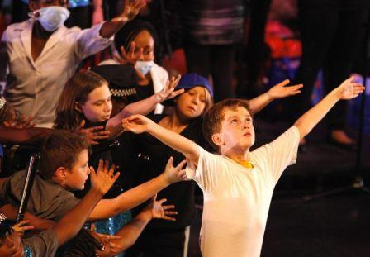
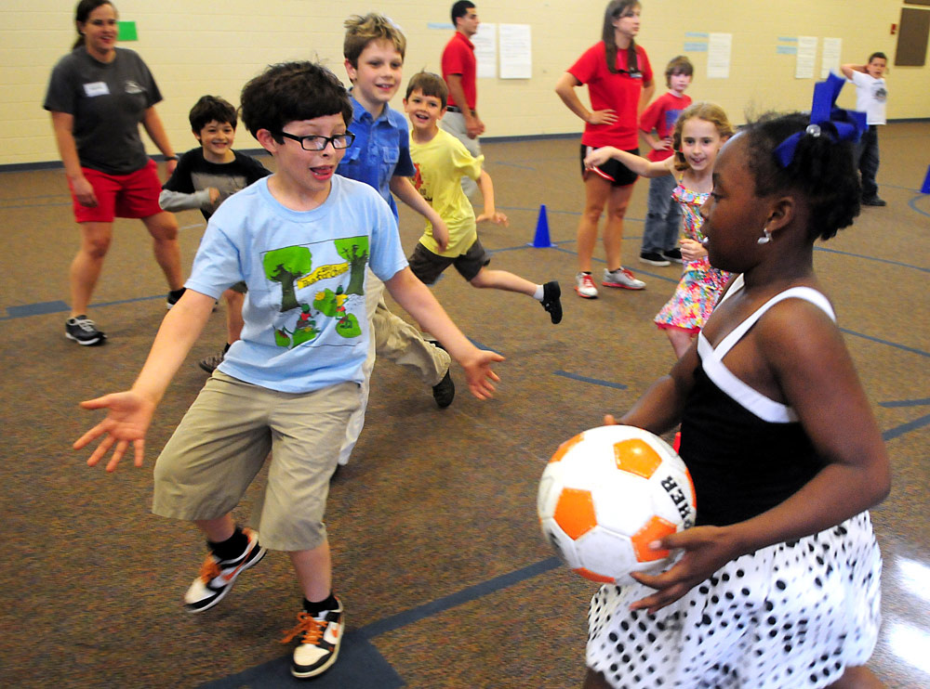
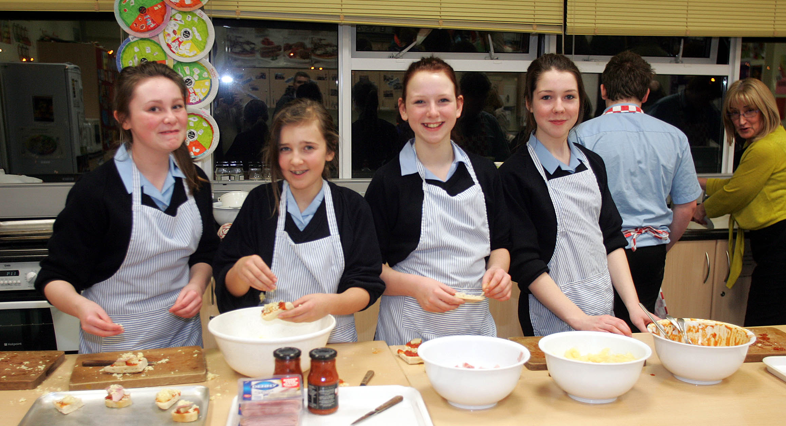

Slide 10
Frills
or fundamentals?

Slide 11
Jensen’s Chapter details a wealth of evidence that movement can be an effective cognitive strategy to:
strengthen learning
improve memory and retrieval
enhance learner motivation and morale

Slide 12
68% of high school students in the United States do not take part in daily physical exercise activities (Grunbaum et al., 2002)

Slide 13
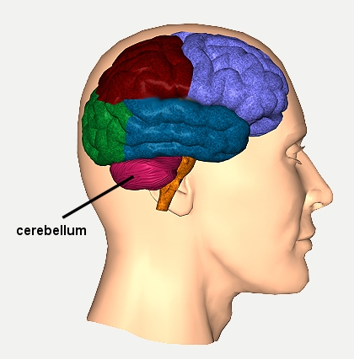
THE CEREBELLUM:
· Area of the brain most associated with motor control
· Takes up only one-tenth of the brain volume (size of a small fist)
· Contains nearly half of all the brains neurons
· Believed to be perhaps most complex part of the brain
· 40 million nerve fibres – 40 times more than even the highly complex optical tract

Slide 14
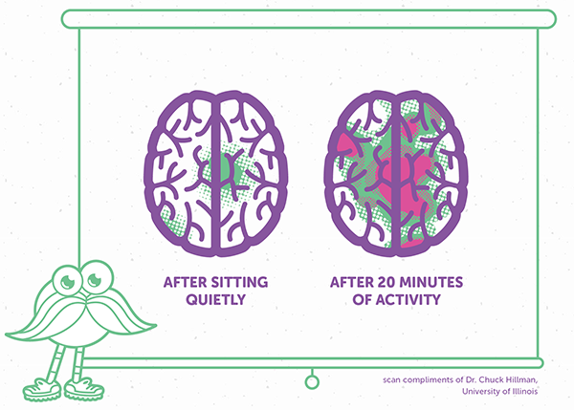
There’s a pathway connecting the cerebellum into parts of the brain involved in:
Memory Attention Spatial Awareness
The same part of the brain
that processes movement is the
same part of the brain
that processes learning

Slide 15
“Something as simple as a quick walk around the building or a trip up and down the stairs can wake up the cerebellum and enable you to refocus.”
Melissa Hughes, Ph.D.

Slide 16
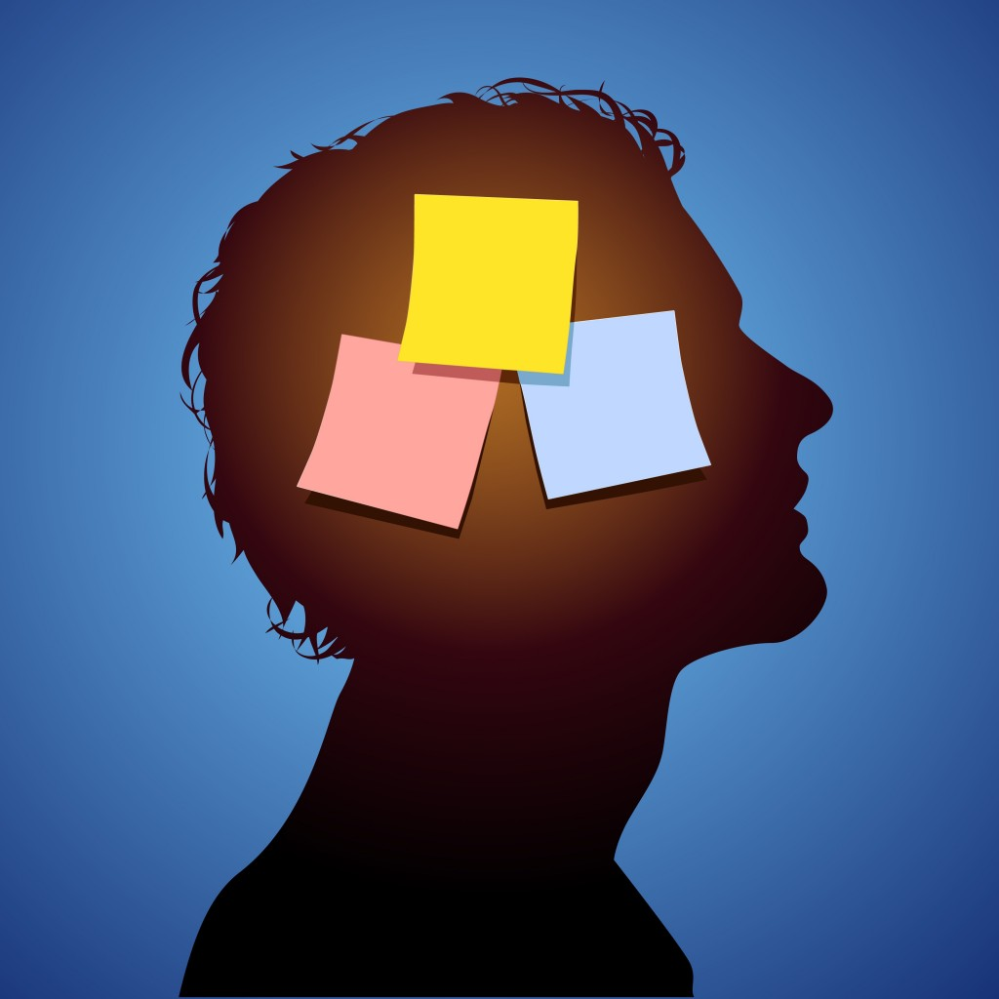
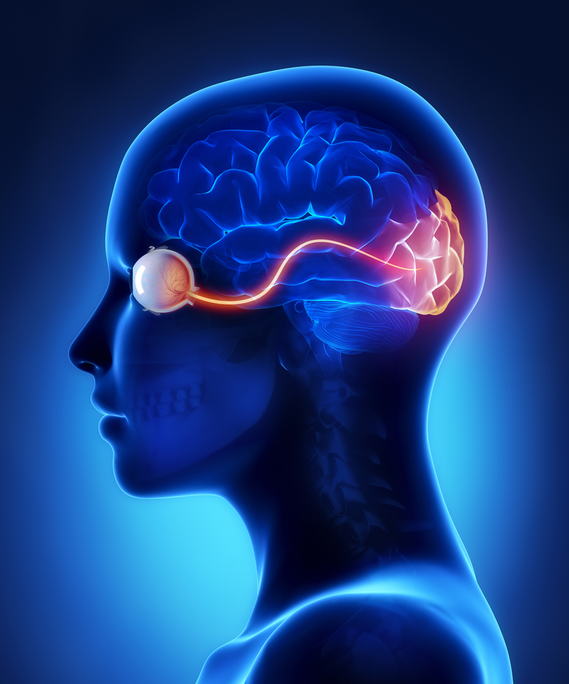
Various studies have shown the relationship between movement and...
Memory
visual system
Desmond, Gabrielli, Wagner, Ginier and Glover, (1997)
Shulman et al., (1997)

Slide 17
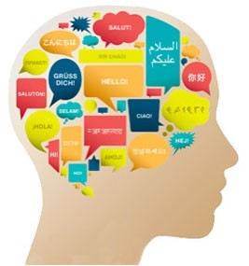
Language Systems
Attention
Kim, Ugirbil, & Strick (1994)
Courchesne & Allen, (1997)

Slide 18
These studies suggest a relationship with the cerebellum in such tasks as:
predicting
sequencing
ordering
timing
practicing or rehearsing a task

Slide 19
Cognitive and
Anatomical Evidence

Slide 20
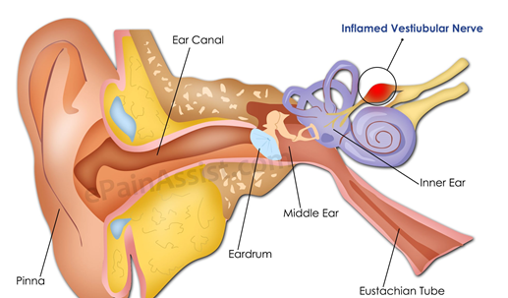
Vestibular System

Slide 21
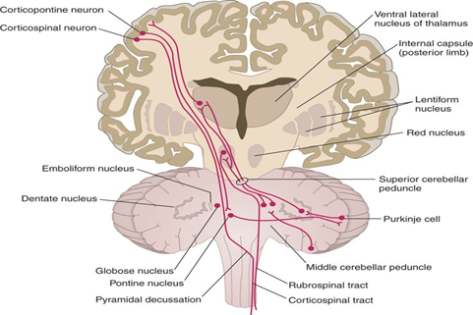
Cerebellar System

Slide 22
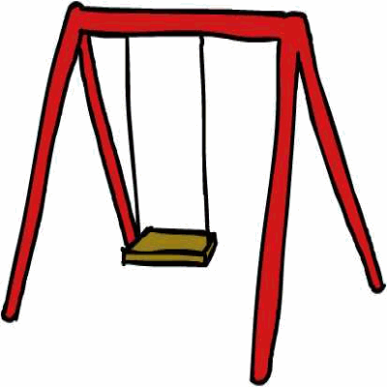
Playground activities such as:
swinging
Rolling
running
jumping
pointing
crawling
stimulate inner ear action.

Slide 23
Lyelle Palmer of Winona State University has document significant gains in attention and reading from stimulating these activities” (Palmer, 2003).

Slide 24
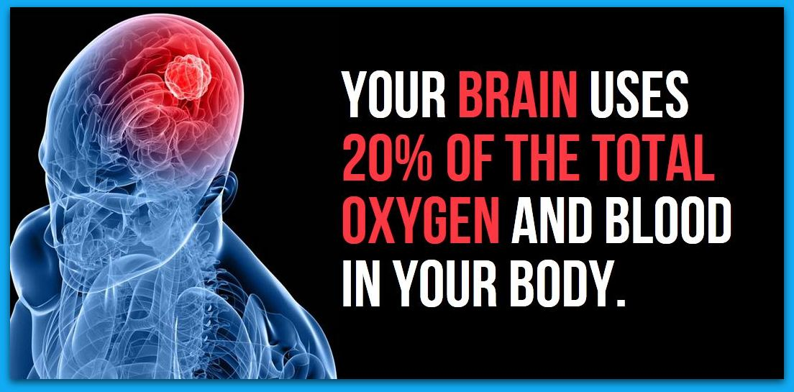

Slide 25
LET’S
MOVE!

Slide 26
Exercise feeds the brain with neurotropins (high-nutrient chemical “packages”, which increase the number of connections between the neurons.
Increase heart rate
Increase EEG activity (electroencephalogram showing brain activity)
Increase in excitatory active brain chemicals

Slide 27
Neuron Activity & Movement
Motor Plan:
What are we doing? Which muscles need to contract, how fast and for how long?
2. Position Sense
Receptors from the muscles are sent through the spinal cord and are tracked into the cerebellum so that the cerebellum is aware of what the message is that is being sent to the muscle and can keep track how the motion is going, if the motion needs to be corrected.
3. Feedback
Motion Plan = is the motion being carried out properly?

Slide 28
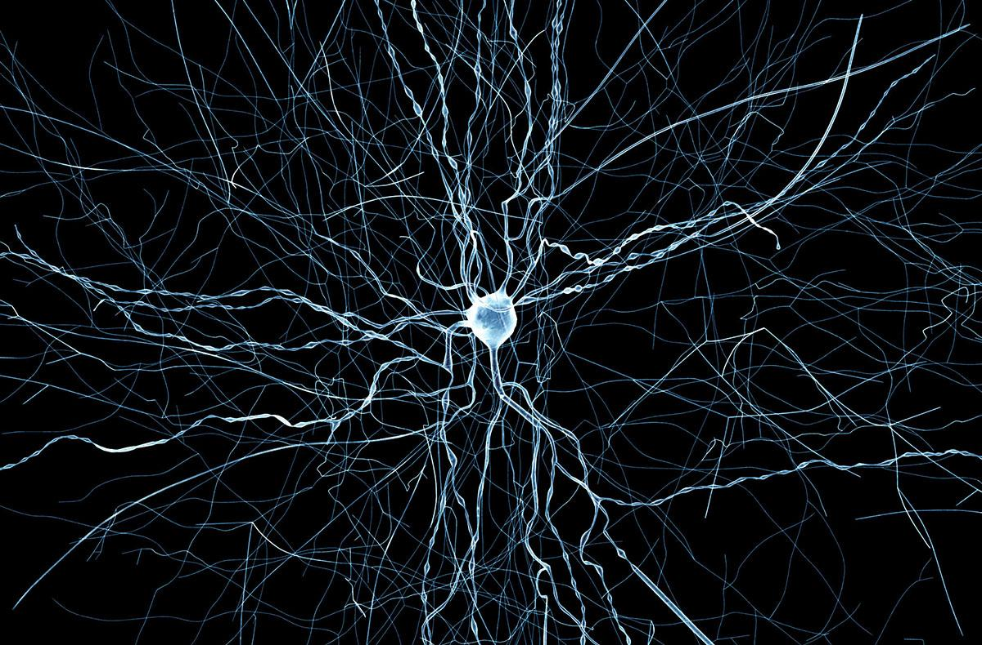
Neuroplasticity
“Neurons that fire together, wire together”

Slide 29
fMRI imaging now shows us that we predict (think about) movements before we execute them (move), thus control them better. Prior to motor activity we engage in rapid thought processes that:
· Set goals
· Analyse variables
· Predict outcomes
“The harder the task you ask of your students, the greater the cerebellar activity” (Ivry, 1997)

Slide 31
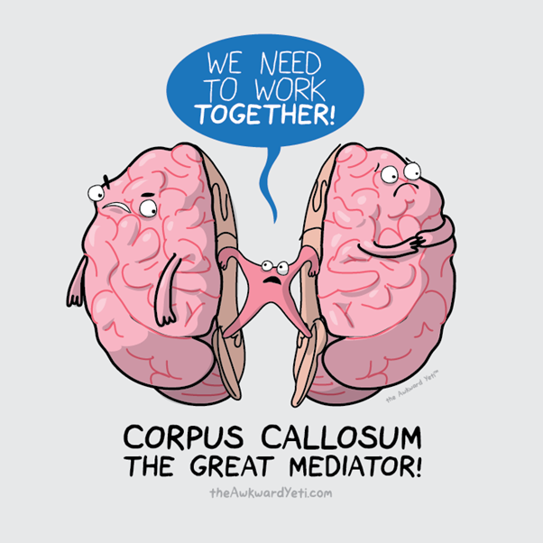

Slide 32
Is the lack of exercise during the school day “educational malpractice”?
Studies link increased cognition to better memory, and reduced likelihood of depression (Kemperman, 2002).

Slide 33
LET’S
MOVE!

Slide 34
Motivation and the Brain
Dopamine: is the chemical that is released in the brain when we are rewarded. It is released when people engage in new activities, such as when a person gambles and wins.
Best way to engage students in what you’re teaching is find ways to increase energy and excitement level up in the classroom. When you increase excitement, have students move around, you increase dopamine levels of your students.

Slide 35
FURTHER SUPPORT
Research by Terrence Dwyer found that exercise improves classroom behaviour alongside academic performance:
An experimental group got four times more exercise per week than a control group (375 minutes vs. 90 minutes).
This “loss” in study time did not result in lower academic results.
Improvement in social skills amongst student who engaged in the increased exercise.

Slide 36
Elementary Teaching Strategy
The belief was that he believed that children learn by doing action. And that it was through imagination that the brain was able to blend the old and the new together to form a new experience.

Slide 37
DAILY PHYSICAL EXERCISE RESULTS IN:
Improved attitude
The ability to make mistakes
Better ways to cope with stress and adreneline
The release of BDNF (brain derived neurotropic factor)
Possible increased catecholamines (norepinephrine and dopamine)

Slide 38
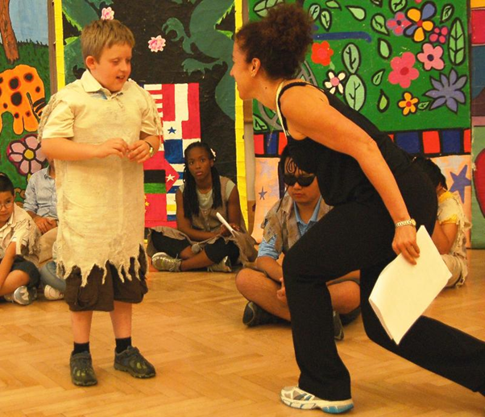
Jenny Seham (National Dance Institute – New York)

Slide 39
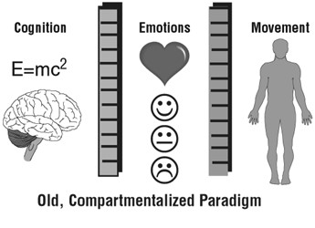
OLD AND NEW UNDERSTANDING OF THE MIND-BODY RELATIONSHIP

Slide 40
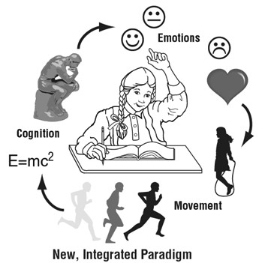
OLD AND NEW UNDERSTANDING OF THE MIND-BODY RELATIONSHIP

Slide 41
“Classroom teachers should have kids move for the same reason that P.E. teachers have kids count”
Larry Abraham, Department of Kinesiology, University of Texas-Austin

Slide 42
BODY BREAK

Slide 43
Kinulations
Dr. Grant Williams

Slide 44
What movement strategies can we use for teaching secondary subjects?

Slide 45
LET’S
MOVE!

Slide 46
Michael Kuczala inspires learning through the use of thoughtful and purposeful movement. He is a bestselling author, acclaimed keynote speaker and innovative professional developer in both education and corporate settings.

Slide 47
Which part of the brain of system controls the basic emotions (fear, pleasure, anger) and drives (hunger, sex, dominance, care of offspring?
prefrontal cortex (spot walking)
limbic system (Touch opposite knees)
Shatner’s Basoon (Upper body jumping jack)
Broca’s area (ear to nose thing)

Slide 48
2. Which area of the brain do we recognise words?
limbic system (spot walking)
Shatner’s Basoon (Touch opposite knees)
Wernicke’s area (Upper body jumping jack)
prefrontal cortex (ear to nose thing)

Slide 49
3. Which area of the brain is usually associated with the production of language?
A. prefrontal cortex (spot walking)
B. limbic system (Touch opposite knees)
C. Shatner’s Basoon (Upper body jumping jack)
D. Broca’s area (ear to nose thing)

Slide 50
4. What does the acronym ‘MEG’ stand for?
Magnetoencephalography (spot walking)
Magentoencephalitisgeography (Touch opposite knees)
Mancanyoupleasegetmeoutofhere (Upper body jumping jack)
I’mjustdoingadanceoverhere (ear to nose thing)

Slide 51
5. You all know that ‘GHOTI’ is said ‘fish’. What does this say: eolotthowghrhoighuay
really big fish (spot walking)
ornithology (Touch opposite knees)
orthography (Upper body jumping jack)
Ain’t no such word (ear to nose thing)

Slide 52
eolotthowghrhoighuay
uses the eo from George, the ol from Colonel, the tth from Matthew, the ow from knowledge, the gh from ghost, the rh from rheumatic, the oi from Beauvoir, the gh from laugh, and the uay from quay

Slide 53
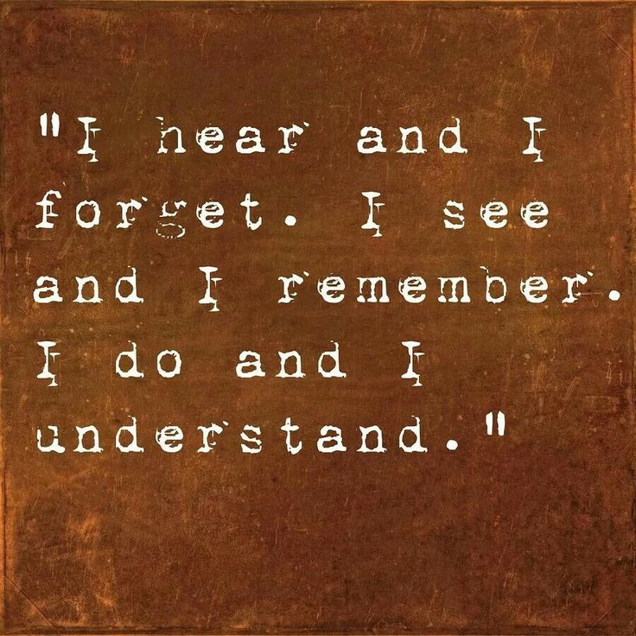
The Kinesthetic Learner
these children learn best when they are allowed to engage their hands and feet as well as their minds
A Kinesthetic learning style is characterized by an ability to retain (memorize) information best when it is related to movement.

Slide 54
Some simple Brain Boosters

Slide 55
LET’S
MOVE!

Slide 56
Cross
Laterals
Cross-lateral movements are those in which arms and legs cross over from one side of the body to the other. The left side of the brain controls the right side of the body, and the right side of the brain controls the left side. Both sides are forced to communicate when arms and legs cross over. This “unsticks” the brain and energizes learning.

Slide 57
ADHD
Larson and Taylor (1998) describe the “characteristics of ADHD (i.e., hyperactivity, impulsivity, and inattentiveness) are manifested as cognitive, affective, and social/behavioral needs.
Commonly, children with ADHD experience difficulties with:
reading
processing
attending to relevant information in the form of texts… presentations
They are often labeled as daydreamers or class clowns
Don’t participating in Socratic seminars
making inappropriate comments while discussing sensitive social topics

Slide 59
A trial-by-trial analysis reveals more intense physical activity is associated with better cognitive control performance in attention-deficit/hyperactivity disorder, has been published online in Child Neuropsychology.
"It turns out that physical movement during cognitive tasks may be a good thing for them," said Julie Schweitzer, professor of psychiatry, director of the UC Davis ADHD Program and study senior author.
"Parents and teachers shouldn't try to keep them still. Let them move while they are doing their work or other challenging cognitive tasks," Schweitzer said. "It may be that the hyperactivity we see in ADHD may actually be beneficial at times. Perhaps the movement increases their arousal level, which leads to better attention.

Slide 60
So what can we do for students who cannot sit still?

Slide 61
For assessment:
try conferencing whilst letting the student stand and move around.

Slide 62
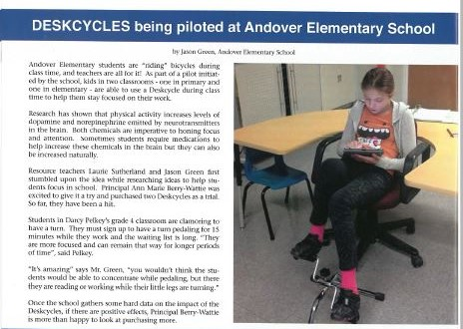
From NBTA News

Slide 63
PRACTICAL SUGGESTIONS
Teachers should not insist students remain in their seats for the entire class
Goal setting on the move
Drama and role-plays
Energizers
Quick games such as ball-toss
Cross laterals
Stretching
Physical education and recess

