Slide 1
The Reading Brain
By:
Kim Stewart
&
Kat McNulty

Slide 2
Outline
Activity: Brainstorm, “What is the definition of reading to you?” and “What is reading?”
Definition of reading
New cultural invention
Parts of the Reading Brain
Activity: Color Confusion
10 minute break
Activity: Testing your reading
How the Reading Brain is studied
Stages of reading
Dyslexia

Slide 3
Brainstorming
On the paper provided, brainstorm:
What do you think is the definition of reading?
What do you think reading is?

Slide 4
What is reading?
Reading: is the ability to understand written
dialogue. It is also the ability to translate written
language into internal dialogue.
Example: When reading Harry Potter, you imagined how Dobby sounded based on the written dialogue you were reading.

Slide 5
It’s New!
We are not born to read, but instead we are like computer programs.
We are born knowing how to breath, but we must learn how to read.

Slide 6
Parts of the Reading Brain
When we read, our brain is taking two functions and streamlining them into one function.
Phonological route decodes letters, making them into sound patterns.
This route relies on the left hemisphere posterior temporoparietal brain region.

Slide 7
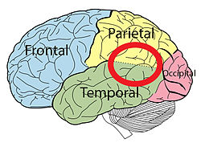
Temporoparietal Brain Region
We use this route to identify words such as cat (c-a-t).
https://en.wikipedia.org/wiki/Temporoparietal_junction

Slide 8
Parts of the Reading Brain Con’t
The second route, engages the left hemisphere posterior occioitotemporal brain region.
This allows us to jump from word to meaning, and is the sight word part of the brain.

Slide 9
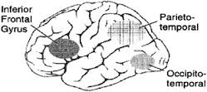
Occioitotemporal Brain Region
We engage this for sight words.
Example: yacht
We do not say y-a-c-h-t.
https://www.youtube.com/watch?v=5kB7GgLlR7M

Slide 10
Rhyme Detection
Read aloud:
Bat and Cat Fat and Bat
Mat and Sat Pat and Dog
If you were attached to a functioning neuroimaging
machine, we could tell that there would be a
millisecond of a delay.

Slide 11
Parts of the Brain Con’t
When experiencing left hemisphere brain strokes, two different impairments can occur.
1) Injuring the phonological route means you
cannot read words that need to be sound out,
but you can still read sight words.
or
2) You injure the phonological route so that you cannot read sight words, but can read words
that need to be sound out.

Slide 12
Color Confusion
RED BLUE WHITE
GREEN PURPLE BLACK
BROWN ORANGE PINK

Slide 13
BREAK!!!!!!
https://www.youtube.com/watch?v=_5qrwbkmlEk

Slide 14
Testing Your Reading
Activity:
Can you read the sheet provided?

Slide 15
https://www.pinterest.com/pin/448882287834023315/

Slide 16
How the Reading Brain is Studied
Technologies used:
fMRIs (Functional Magnetic Resonance Imaging)
ERPs (Event Related Potentials)
MEGs (Magnetoencophalography)

Slide 17
Stages of Reading
Stage 0: From birth to Grade One
Stage 1: Grades One and Two
Stage 2: Grades Two and Three
Stage 3: Grades Four to Eight
Stage 4: Grades Nine and Twelve
http://www.medicaldaily.com/science-speed-reading-benefits-and-consequences-reading-1000-pages-10-hours-316828

Slide 18
https://i.ytimg.com/vi/AZ6HKCAhcAc/maxresdefault.jpg

Slide 19
Dyslexia
About 5-17% of children are diagnosed with developmental dyslexia.
It is the most common reading disability
People with dyslexia have a weakness in phonological processing skills.
Involves difficulty in auditory and visual perception, and automatic ability. https://www.youtube.com/watch?v=zafiGBrFkRM
“friends” = “frens”

Slide 20
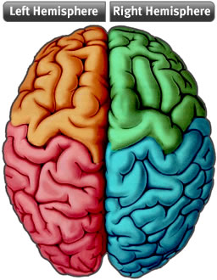
Dyslexia Con’t
People with dyslexia experiences constant decreasing, and absent, activity in their left posterior.
Adolescents with dyslexia compensate by using their frontal brain regions.
http://userscontent2.emaze.com/images/4a76cf2a-eed5-4e02-963e-9c62f71f773d/476929d4-a17d-4daf-a904-52762623d337.jpg

Slide 21
References
Santrock, J.W. (2001). Educational Psychology. Toronto: McGraw Hill Companies Inc.
Sousa, D. A. (Ed.) (2010). Mind, brain & education: Neuroscience implications for the classroom. Bloomington, IN: Solution Tree Press

